Slide 1

CREDIT CASE STUDY
EXPLORATORY DATA ANALYSIS

Slide 2
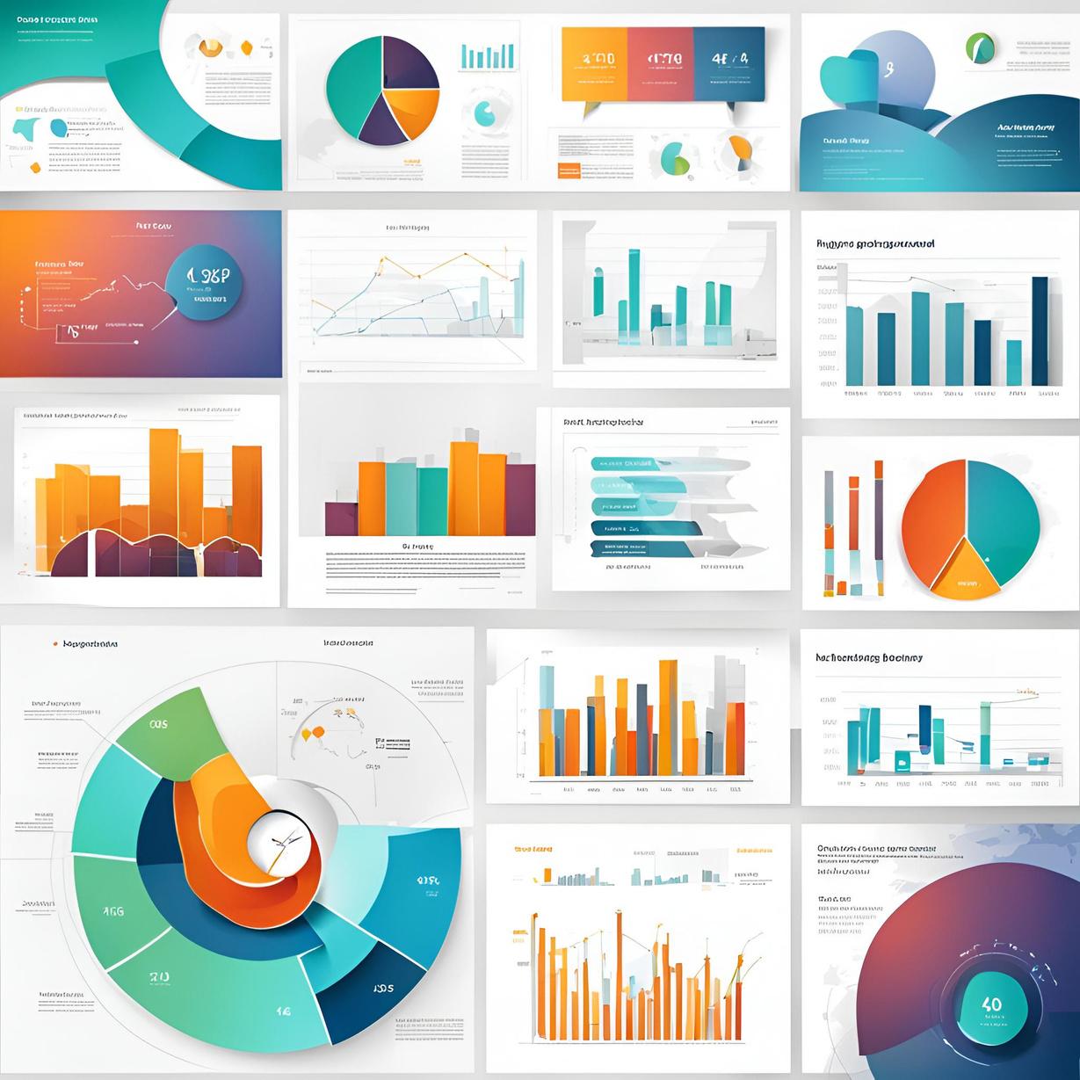


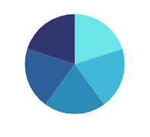
EDA OBJECTIVES
EDA is to help look at data before making any assumptions. It can help identify obvious errors, patterns, outliers or, find relational variables.
BUSINESS UNDERSTANDING
Problem: Loan companies struggle to evaluate applicants with little or no credit history, making it hard to decide who will repay their loans.
BUSINESS OBJECTIVES
Identify patterns that show if a client might have trouble paying back a loan.

Slide 3
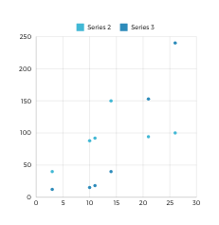
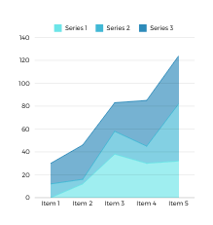
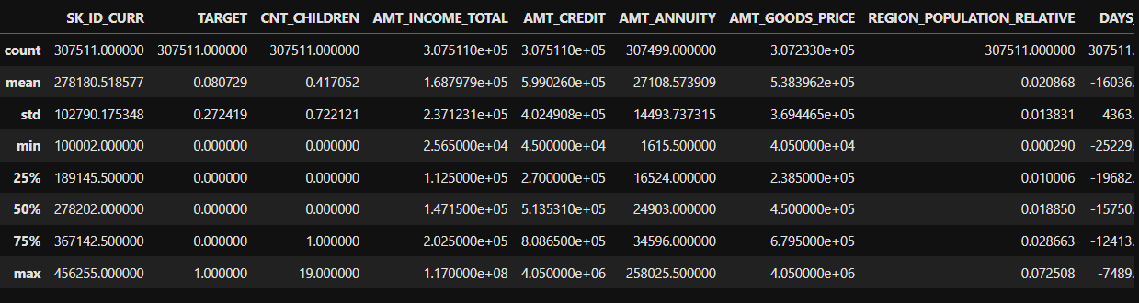

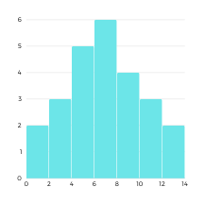
PREPARATIONS
Understanding Data
Cleaning Data
Describing Data
Data Manulpulation

Slide 4

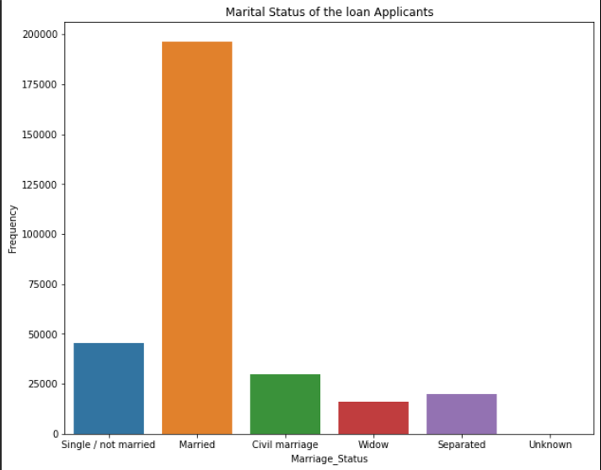
Univariate analysis
on Marital Status of Applicants
OBJECTIVE:
To get the basic idea about the applicants Family Background
Trend/Pattern:
Most of the applicants are from Married background followed by Single/ Not Married

Slide 5

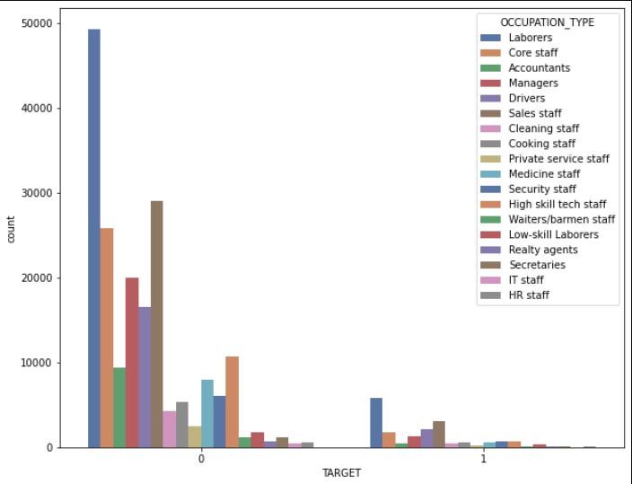
OBJECTIVE:
Get an overview on the payment difficulties based on occupation of applicants
Target Distribution
acc to Occupation
Trend/Pattern:
Few applicants from every occupation are having trouble in payment difficulties comparing number of application

Slide 6

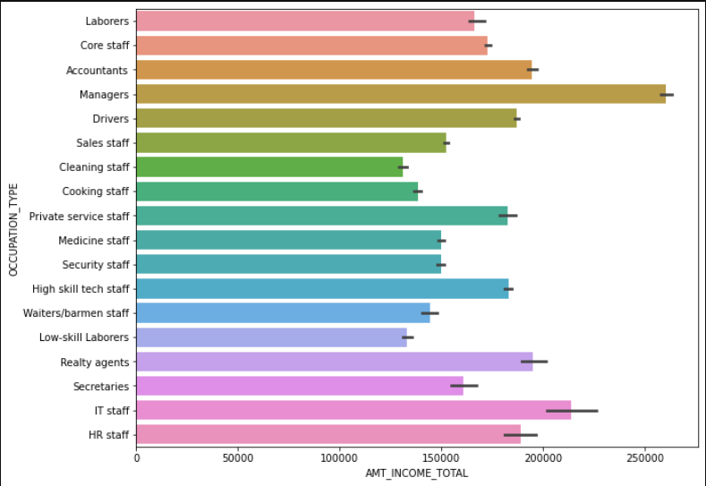
Income distribution w.r.t Occupation
OBJECTIVE:
Understanding Income v/s Occupation Trend
Pattern:
As labors are having above avg income still the num of applicants for credit are more compared to low-skill labors with avg income

Slide 7

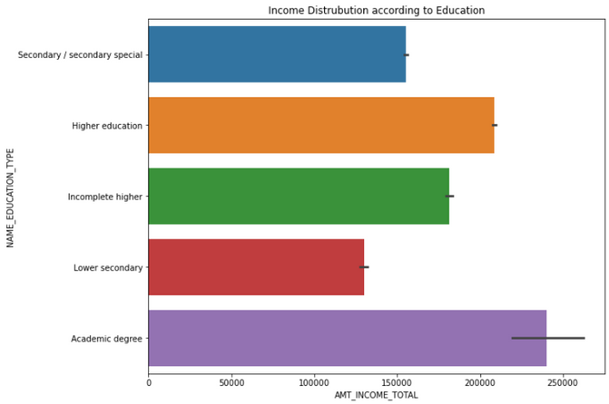
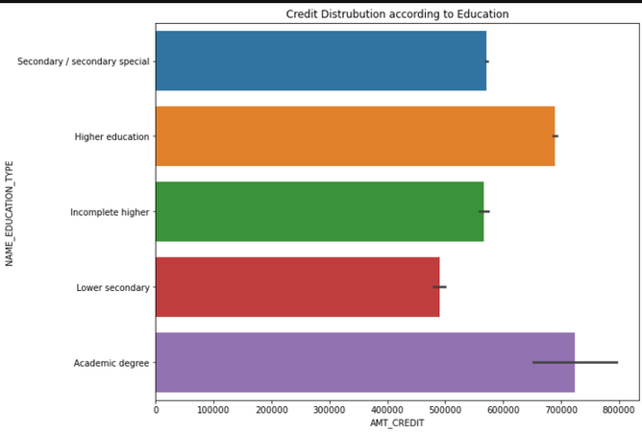
Education v/s Income
OBJECTIVE:
Find a Relation between Income and Credit keeping the as the Education common Factor
Credit v/s Education
Trends/Patterns:
Secondary and Incomplete Higher are having almost same credit but unequal Income
Same is the case with Higher education and Academic degree

Slide 8

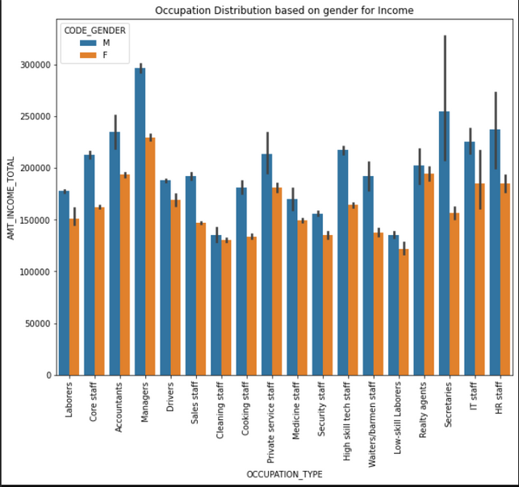
OBJECTIVE:
Getting a rough idea of F & M distribution across all occupation with their respective income
Occupation Distribution based on gender for Income
Trends/Pattern:
In all sectors M are having higher Income with managers being the highest income for both M and F

Slide 9


Observations:
Majority of loan applicants are married, with a frequency of around 250,000, followed by single/not married applicants. but focusing of other 3 groups could be beneficial.
Laborers are the most common occupation among loan applicants (55,000), followed by core staff (30,000) and managers (25,000). Fewer applicants belong to other occupations.
Drivers have the highest average total income (250,000), followed by managers (220,000) and core staff (200,000). HR staff have the lowest average total income (120,000).
Higher education and academic degrees are associated with 67% and 100% higher incomes, respectively, compared to secondary and incomplete higher education. Credit amounts increase by 33% and 67% with higher education and academic degrees, respectively.
Men consistently earn more than women across most occupations, with significant disparities in roles like managers, drivers, and IT staff.

Slide 10


